Slide 1

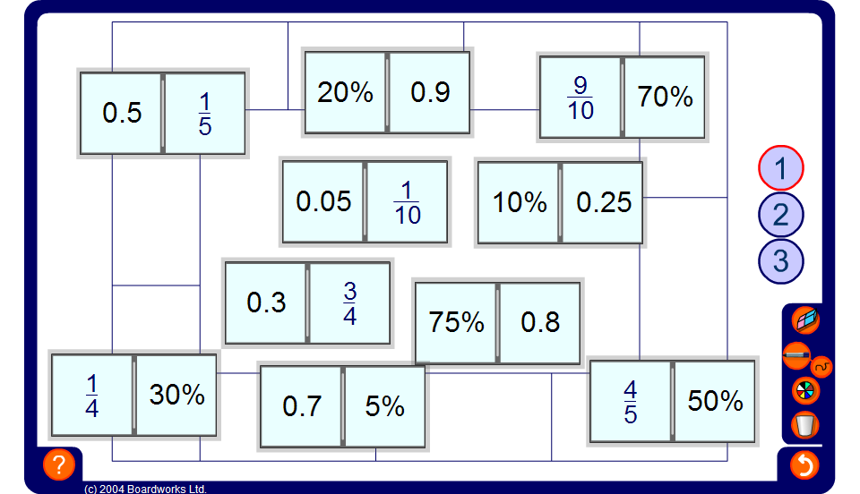


Dominoes
Notes:
Start by selecting a domino at random and placing it in the loop.
Select a volunteer to place a domino at either side end ensuring that an equivalent fraction, decimal or percentage is matched up.
Discuss briefly the methods used to perform the conversion.
Continue until all the dominoes have been placed.

